Slide 1
Integrating Outcome Measures into Clinical Practice: You NEED to Do This
Tom Abdenour, DHSc ATC CES
Head Athletic Trainer
San Diego State University
tabdenour@mail.sdsu.edu

Slide 2
What do we hope to learn today?
Outcome scales
philosophy of outcomes measurement
application as an EBM tool
how they are developed
“ceiling effect” & need for athletic versions of outcome scales
Example of some outcome scales
low back
foot/ankle
knee joint & patellofemoral
upper extremity
HRQOL
ALBO (Athletic Low Back Outcome)

Slide 3
Challenges
Show of hands.....how many:
incorporate outcome scales on a routine basis
incorporate outcome scales on occasion
have used outcome scales but have discontinued using them
are not familiar with outcome scales

Slide 4
Philosophy
What are “outcomes”?
“study of the end result of health services that take the patient’s experiences, preferences and values into account”
Objective of measuring outcomes
monitor course of care & rehab
assess end result of rehab
critical component of EBM
Valovich McLeod, T. C., et al 2008.
Irrgang, J. J., et al. 2001.

Slide 5
Philosophy (continued)
Starting point: Evidence Based Medicine
EBM for ATC
critical for ATC to adopt these concepts
enhance quality of care
enhance communication of all involved in patient’s care
Steves, R., Hootman, J. M. 2004.
Denegar, C. 2008.

Slide 6
Philosophy (continued)
Evidence Based Medicine is the integration of:
best research evidence
clinically relevant patient-oriented research
new research replaces old tests & measurements with new
clinical expertise
use of our clinical skills & past experiences
“do what we do best”
patient values
concerns and expectations of each unique patient
all is based on individual clinical circumstances.
Straus, S. E. et al. 2005.

Slide 7
Philosophy (continued)
We need to understand & assimilate patient-oriented evidence that matters (POEM)
POEM focuses on effect of disease process.
Disease-oriented evidence
pathology
mechanism of injury
controlled laboratory studies
Valovich McLeod, T. C., et al 2008.

Slide 8
Philosophy (continued)
POEM gives greater understanding of the true effect of the injury or condition
includes Health Related Quality of Life (HRQOL)
symptoms or issues that are of concern to patient
as a rule, we have overlooked concept of POEM in our work.
POEM studies are important advancements for OUR profession.
Valovich McLeod, T. C., et al 2008.

Slide 9
Outcome scales do not replace:
Clinical exam
Flexibility/ROM
Strength
Balance
Functional exam
Tests to mimic athletic activity
Sprints/agility test
Medical exam
Diagnostic exam
Images
Good old fashioned visit with the doc

Slide 10
Goals
improve embracing outcomes assessment
enhance practitioner education
create outcomes measures that are relevant to our patient population
the athletic population
pierce the ceiling

Slide 11
Benefits
Communication:
90% AT: enhance the practitioner—patient communication
80% AT: enhanced practitioner—colleague communication
60% psychologists: enhanced practitioner – parent communication
87% AT: enhances plan of care
78% AT: patients believe clinician is more thorough
71% AT: attain overall better outcomes
62% AT: enhance patient motivation and encouragement

Slide 12
Benefits (continued)
improve overall quality of treatment
help focus treatment
facilitated discharge planning

Slide 13
Description
What are they???
‘paper & pencil’ tests
symptoms
some scales focus on function…..others on dysfunction

Slide 14
Description (continued)
Form should cover
various conditions which could afflict athlete/patient
questions should be scored for quantification
some form of ranking system (i.e. Likert scale).
0-10 pain or function scale
10 cm line
Administration
initial at onset of injury
serially until rehab complete

Slide 15
Regions
Body region: specific
Body region: general
HRQOL
Snyder Valier et al, 2014

Slide 16
Examples
HRQOL
SF-36
Upper Body
Kerlan-Jobe Orthopaedic Clinic (KJOC) Shoulder & Elbow Score
Patellofemoral
VISA Scale
Foot & Ankle
Foot and Ankle Ability Measure
Low Back
Modified Oswestry Questionnaire

Slide 17
HRQOL
Health Related Quality of Life (HRQOL)
ATC instinct to evaluate strength, ROM, etc.
HRQOL self-report to evaluate:
physical
psychological
social
Based on
personal experiences & expectations
Self-report tools
SF 36 & SF 12
Snyder et al, 2010

Slide 18
Upper Extremity
Kerlan-Jobe Orthopaedic Clinic (KJOC) Shoulder & Elbow Score
KJOC Scale
Visual Analog Scale “place an X on the line”
Background & demographic information
10 questions relative to
pain, weakness, instability during activity
impact of injury on function: throw, serve, stroke, etc
Alberta, F. G., et al. 2010

Slide 19
Patellofemoral Scale: VISA scale
Questions:
0 points (dysfunction) -- 10 points (optimal function)
six questions: pain/symptoms
length of time to sit pain free
pain walking downstairs
pain with non-WB knee extension
pain with lunge
pain with squatting
pain with 10 hops
two: ability to participate in sport activity
sport participation
pain with sport activity
total: 100 points

Slide 20
Foot and Ankle Scale
Foot & Ankle Ability Measure (FAAM & Sport)
FAAM (ADL) & SPORT
0—5 points
No difficulty -- Unable
FAAM: assess ADL
walking: flat, hills, uneven ground for time
ADL in general
pushing/pulling
FAAM sport: athletic oriented
running, jumping, landing, cutting
ability to participate in sporting activity
Hcarcia, C. R., Martin, R. L, Drouin, J. M. 2008

Slide 21
Low Back Scales
Comparing low back scales
upwards of 24 different low back scales
primary focus is on ADL.
Minimum detectable change: extent of change to be 90% confident that the observed change is real
Criteria for clinical utility
Self-administered
Brief
Easy to complete
Simple to score
Davidson, M. Keating, J. L. 2002.

Slide 22
Low Back Scales (continued)
Modified Oswestry Questionnaire
10 questions relative to ADL
score re: disability
0 = normal
5 = dysfunctional
50 = complete dysfunction
walking
sitting
standing
lifting
Fritz, J. M., Irrgang, J. J. (2001)

Slide 23
Need for athletic version
Study scholastic students and student-athletes with low back injury:
athletes showed less improvement than non-athletes.
did athletes have lower levels of baseline disability?? (= higher levels of functional ability)
athletes with lower baseline had less of a margin of improvement.
Fritz, J. M. Clifford, S. N. 2010.

Slide 24
Need for athletic version
Re-injury rate
Yale Univ: presence of low back pain at the beginning of season indicated a six fold increase in risk of sustaining LS injury in the following year.
Incidence of LS strain in NBA
survey of 17 seasons: low back injury = 10.2% of all time lost injuries.
Greene, H. S. et al 2001.
Drakos, M.C. et al 2010.

Slide 25
Ceiling Effect
Inability for scale to assess high ability range.
Potential limitation for scales used by highly functioning athletes.
Many routine scales do not adequately measure athlete’s functional recovery.
Problem: as rehab progresses, scale may not reflect precise functional ability.
Reider, B. 2010.

Slide 26
ALBO scale
ALBO Scale
Low Back outcome scale for the athletic patient based on ADL and athletic function.
In memory of Dr. Robert J. Albo, Golden State Warriors

Slide 27
ALBO scale

Slide 28
ALBO scale
Components
Demographic information
Part 1: compare athletic function today to prior days in which scale was completed.
Part 2: ADL
6 questions: 0 (impossible) – 10 (normal)
Part 3: Athletic Function
10 questions: 0 (impossible) --- 10 (normal)

Slide 29
ALBO scale (continued)
Part 1: Overall, how would you describe your ability to function as an athlete compared to the last time you completed this form:
A. better
B. essentially the same
C. worse
D. this is my initial completion of the form

Slide 30
ALBO scale (continued)
Part 2: Please answer these questions based on your current daily activity health due to your back pain. How difficult is it to:
PLEASE CIRCLE THE BEST ANSWER:
0 (impossible) – 10 (normal)
0 1 2 3 4 5 6 7 8 9 10

Slide 31
ALBO scale (continued)
Questions re: ADL function (continued)
drive > 30 min
sit > 30 min
walk > 30 min
stand > 30 min
shoes/socks
sleep comfortably

Slide 32
ALBO scale (continued)
% ADL Function
Total Points (sum of all answers) = ________
Number of available points (# questions answered x 10) = (maximum = 60)
% daily activity function = ________ (total points / number of available points) x 100.
= % ADL Function

Slide 33
ALBO scale (continued)
Part 3: Athletic Function (continued)
0 (impossible) – 10 (normal)
Athletic Skill
Non-contact sport specific skills
Partial team practice (drills & ‘live’ scrimmaging)
Full team practice w/o restriction
Competition: what is your ability to compete today?

Slide 34
ALBO scale (continued)
Part 3: Athletic Function (continued)
PLEASE CIRCLE THE BEST ANSWER:
0 (impossible) – 10 (normal)
0 1 2 3 4 5 6 7 8 9 10
upper body strength training
lower body strength training
core strength training
explosive strength training
general fitness
any motion involving rotation

Slide 35
ALBO scale (continued)
% Athletic Function
Total Points (sum of all answers) = ________
Number of available points (# answers x 10) ________ (maximum = 100)
% Athletic function = ________ (total points / max number of available points) x 100
= % of Athletic Function

Slide 36
Excuses to not use outcome scales
Too much time to complete
Information not valuable
Didn’t learn this as ATS
I am not sure about this whole evidence based thing

Slide 37
Challenges
Outcome scales not part of your routine….you are not alone
74% AT do not routinely use
We are not alone…..
> 50% PTs do not use
60% psychologists do not use
80% psychiatrists do not use
Snyder Valier, et al 2014

Slide 38
Challenges (continued)
Compliance “buying in”
one more thing for ATC to do
one more form for athlete-patient to complete
Keeping track of timing
daily is too frequent
weekly or bi-weekly somewhat work based on frequency of treatment visit.
one final completion at RTP.

Slide 39
Drawbacks by AT who do not use POEM
46%: time consuming to complete
31%: time consuming to analyze
29%: lack of administrative support
25%: simply not worth the effort
Bottom line: POEM simply does not meet the clinician’s needs

Slide 40
Drawbacks by AT who use POEM
Sentiments from AT as to drawbacks
44%: time consuming
36%: difficult to execute
31%: confusing
29% thought it was time consuming & confusing for patients
In general AT were ‘uncomfortable’ with technical aspects
scoring
interpretation of information

Slide 41
Outcome Scale “kissin’ cousin”
Example of paper/pencil test familiar to many of us.
Assist all re: tracking injury progress
Can be completed alone by athlete-patient OR with assistance of ATS or ATC
Does not meet precise definition of outcome scale but is similar in the sense how it is completed and what it is used for.

Slide 42
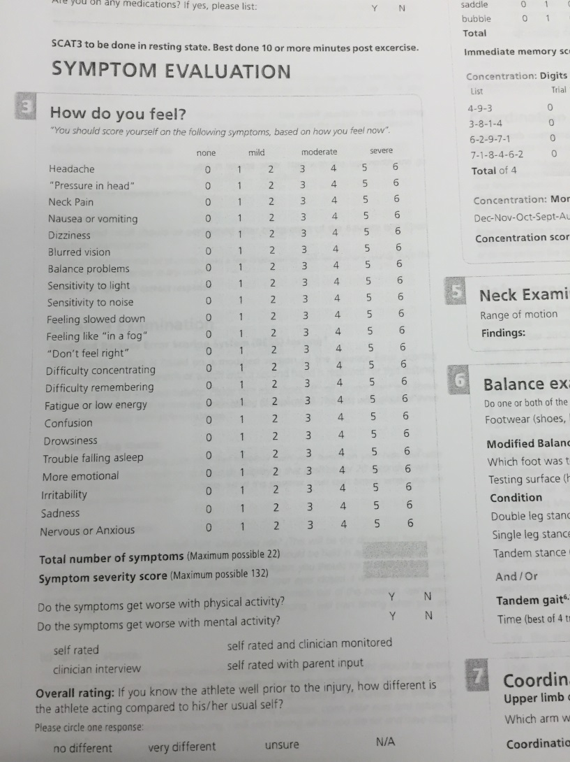
SCAT 3

Slide 43
Old School New School
How do you feel today: better, worse, same | Pain scale: 0-10 (10 = bad) Function scale: 0-10 (10 = good)
Which activity bothers you? | Specific activity re: ADL: sit for how many minutes…..walk on uneven surfaces
Questions about function might not be recorded as completely | To what extent does athletic activity bothers you: throw, run, jump…..
 | Simple objective evidence
Somewhat subjective “% RTP” | Gives better feel of FAQ: “what % of RTP am I”.
 | Get better feel of psychological preparation for RTP

Slide 44
What have we learned today????
Outcome scales
Philosophy & application of outcome scales as EBM tool
Challenges have been acknowledged
Benefits are significant
Example of scales
Pathology & quality of life
Role of disability scales for general patient & athletic patient.
How ‘ceiling effect’ affects athletic patient

Slide 45
References
Steves, R. , Hootman, J. M. Evidence-based medicine: what is it and how does it ?? to athletic training. J Athl Train. 2004, 39: 83-87.
Denegar, C. Advancing patient care: everyone wins. J Athl Train, 2008, 43: 341.
Snyder Valier, A.R., Jennings, A. L., Parsons, J. T., Vela, L. I. Benefits of and barriers to using patient-rated outcome measures in athletic training. J Athl Train, 2014, 49: 674-683.
Straus, S. E., Richardson, W. S., Glasziou, P., Haynes, R. B. Evidence-based medicine. How to teach and practice EBM. 3rd edition, Elsivier Churchill Livingstone, Edinburgh.
Valovich McLeod, T. C., Snyder, A. R., Parsons, J. T., Bay, R. C., Michner, L. A. Sauers, E. L. Using disablement models and clinical outcomes assessment to enable evidence-based athletic training practice, part I: disablement models. J Athl Train, 2008; 43: 428-436.
Irrgang, J. J., Anderson, A. F., Boland, A. L., Harner, C. D., Kurosaka, M., Neyret, P., Richmond, J. C., Shelborne, K. D. Development and validation of the International Knee Documentation Committee Subjective Knee Form. Am J Sports Med. 2001; 29: 600-613.

Slide 46
References (continued)
Snyder, A. R., Martinez, J. C., Bay, R. C., Parsons, J. T., Sauers, E., L. Valovich McLeod, T. C. Health-related quality of life differs between adolescent athletes and adolescent nonathletes. J Sport Rehab; 19: 237-248.
Alberta, F. G, ElAttrche, N. S., Bissell, S., Mohr, K., Browdy, J., Yocum, L., Jobe, F. The development and validation of a functional assessment tool for the upper extremity in the overhead athlete. Am J Sport Med. 2010; 38: 903-911.
Visentini P. J. , Kahn, K. M., Cook, J. L., Kiss, Z. S., Harcourt, P. R. , Wark. J. D. The VISA score: an index of severity of symptoms in patients with jumper’s knee (patellar tendinosis). Victorian Institute of Sport Tendon Study Group. J Sci Med Sport. 1998; 1: 22-28.
Carcia, C. R., Martin, R. L., Drouin, J. M. Validity of he Foot and Ankle Ability Measure in Athletes with Chronic Ankle Instability. J Athl Train. 2008; 43: 179-183.
Fritz, J. M., Irrgang, J. J. A comparison of a Modified Oswestry low back pain disability questionnaire and the Quebec Pain Disability Scale. Phys Ther. 2001; 81: 776-788.

Slide 47
References (continued)
Davidson, M. Keating, J. L. A comparison of five low back disability questionnaires: reliability and responsiveness. Phys Ther. 2002; 82: 8-24.
Greene, H. S., Cholweicki, J., Galloway, M. T., Nguyen, C. V., Radebold, A. A history of low back is a risk factor for recurrent back injuries in varsity athletes. Am J Sport Med. 2001; 29: 795-800.
Drakos, M. C., Domb, D. Starkey, C., Callahan, L., Allen, A. A. , Injury in the National Basketball Association: a 17-year overview. Sport Health. 2010; 2: 284-290.
Fritz, J. M. Clifford, S. N. Low back pain in adolescents: a comparison of clinical outcomes in sports participants and nonparticipants. J Athl Train. 2010; 45: 61-66.
Reider, B. Dancing on the ceiling. Am J Sport Med. 2010; 38: 1531-1532.

Slide 48
Thanks
Kris Boyle-Walker, MPT, OCS, ATC, CHT
Kavin Tsang, PhD, ATC
Carolyn Peters, MS, ATC
My committee at ATSU

Slide 49
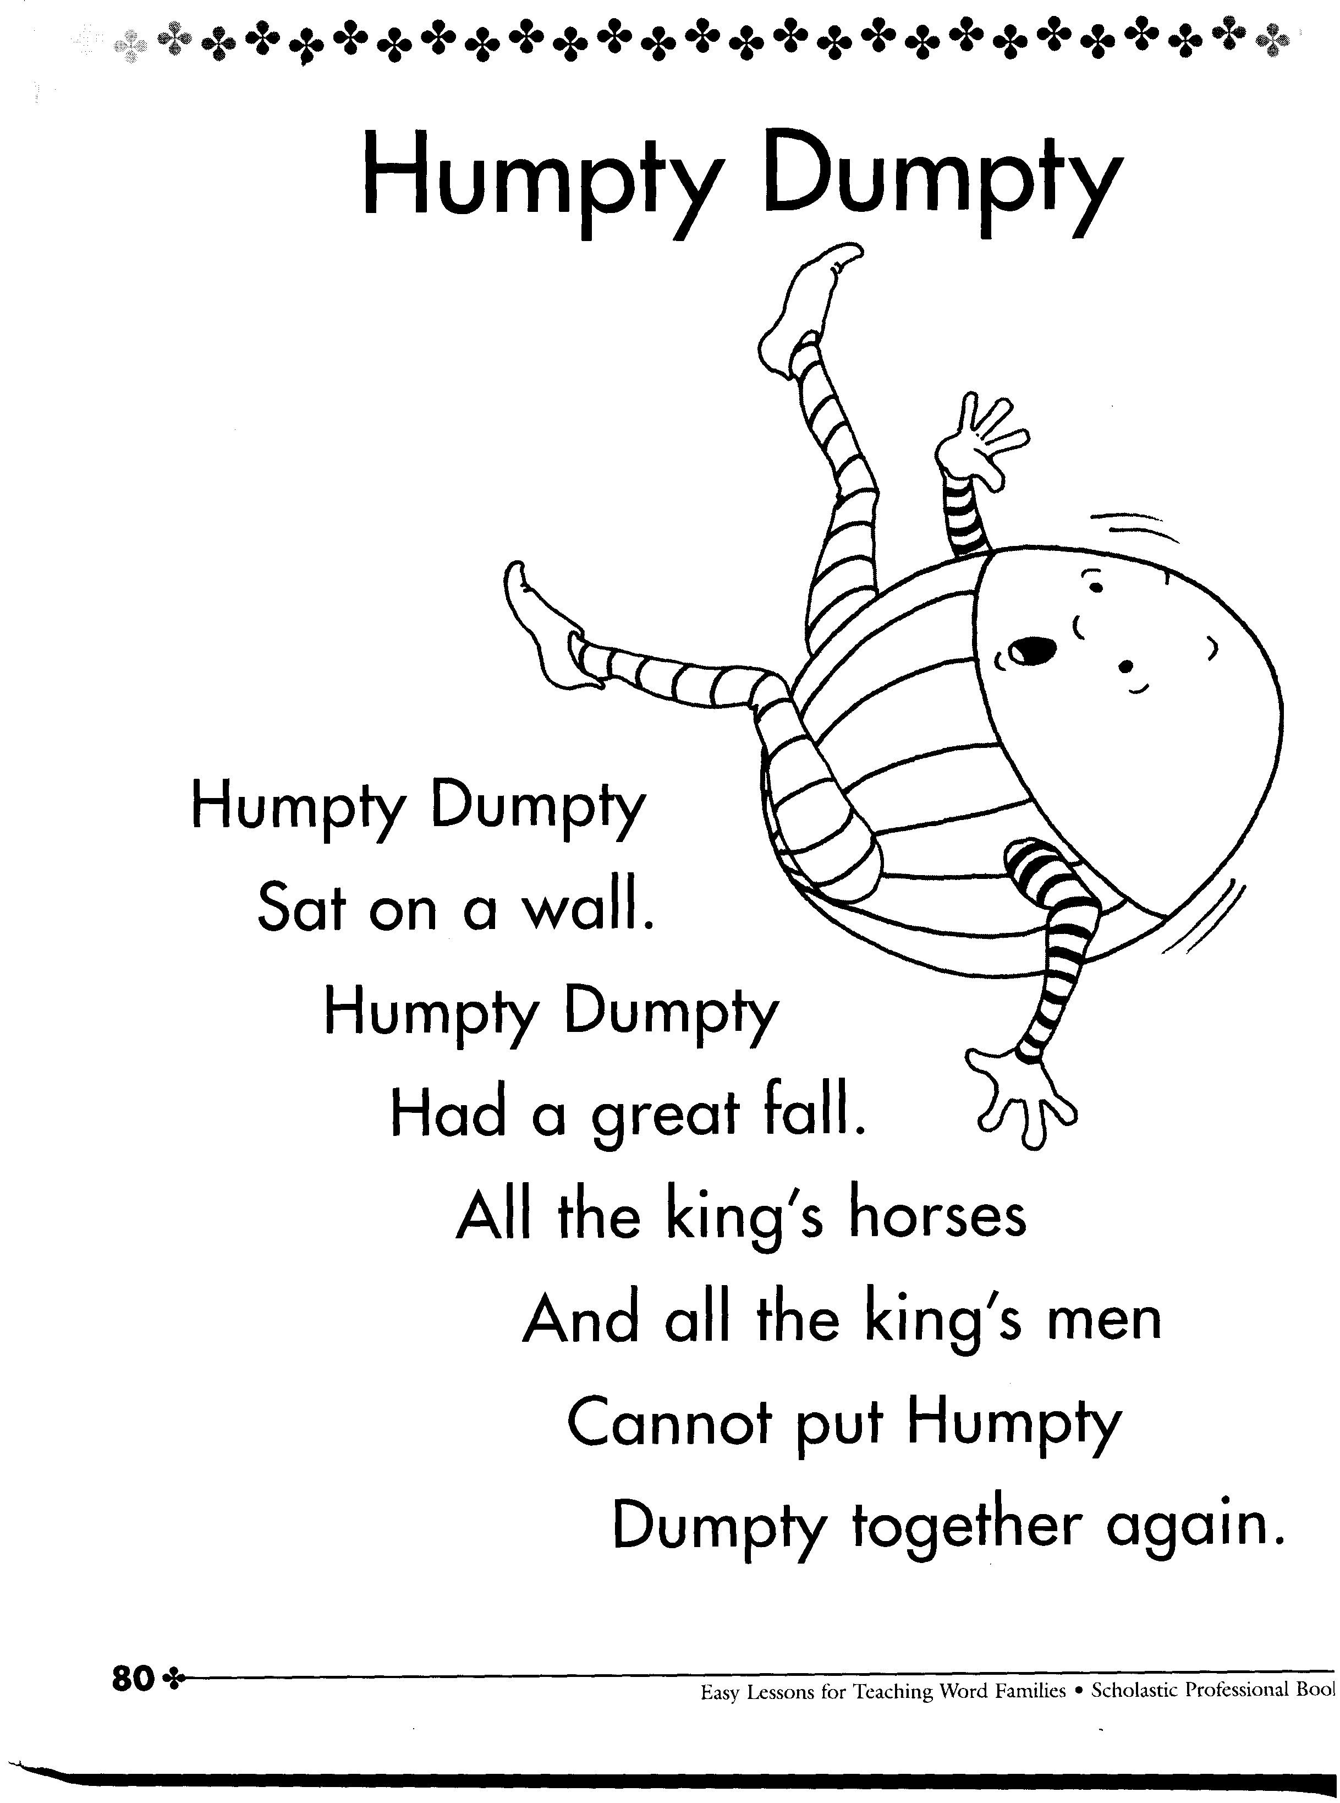
Final Thought… he should have called us……

